Slide 1
Freddie Mercury
And his family’s refugee journey…
By Riah
2nd Grade Of High School

Slide 2
An introduction to his early life
On September 5, 1946, Farrokh Bulsara was born in Stone Town, Zanzibar. His parents, Bomi and Jer, who were Parses from India, moved to Zanzibar shortly after being married so Bomi could continue his work as a cashier for the British Colonel Office. Farrokh was sent to St. Peter’s School in India, a British-style boarding school where he also studied piano. During his time there, he joined his first band at the age of 12 called the Hectics. He moved back to Zanzibar in February of 1963 at age 17.

Slide 3
About the Zanzibar Revolution
The Zanzibar Revolution broke out on January 12, 1964. It was an attempt to bring down the long-standing economic inequality since the most privileged and wealthiest people in Zanzibar were either Arab or South Asian. After several months of slaughter, more than 20,000 Arabs were murdered along with thousands of Indians. Tens of thousands had fled the island, searching for safety.

Slide 4
The Bulsara family was among those who left Zanzibar during the violence. They moved to Feltham, England. Mercury became a registered citizen of the United Kingdom on June 2, 1969, the same year he graduated from Ealing Art School where he studied art and design. The next year, Mercury joined guitarist Brian May and drummer Roger Taylor’s band Smile, which became the rock band that would grow to become one of the single most famous bands of all time: Queen. It was at this time that Farrokh Bulsara changed his name to Freddie Mercury.

Slide 5
Live Aid
Not only did Queen have Freddie Mercury the refugee as their lead singer but the band also contributed to one of the largest concerts in history. Live Aid was a benefit concert held on July 13, 1985, to raise money for famine relief in Africa. The concert began at Wembley Stadium in London and continued at JFK Stadium in Philadelphia and several other venues worldwide. This created the 16-hour “superconcert,” covered by 13 different satellites and broadcasted to more than a billion people in 110 nations.

Slide 6
The concert included all the big stars: Elton John, Madonna, The Beach Boys, The Who, Mick Jagger, Eric Clapton and David Bowie to name a few. But, one of the most memorable performances was Queen. By the 80s, the band was slowly losing traction but very unexpectedly stole the show with their 20-minute set. By the end of the day, Live Aid had raised $127 million in famine relief for the African nations in need and generated enough publicity to get Western nations involved. They made enough surplus grain available to end the immediate hunger crisis in Africa.

Slide 7
Why This Matters
The International Rescue Committee launched a global campaign on June 17, 2019, to help raise awareness for refugee support for World Refuge Day.The campaign highlighted contributions refugees have made and are still making to society. Freddie Mercury the refugee was featured in this campaign, listing him with others, such as Albert Einstein, as leaders who have helped shape the world.

Slide 8
There are an unprecedented 70.8 million refugees worldwide, people who have been forcibly displaced from their homes, and every day more are forced to flee. That means there are almost 71 million people who are in need of aid and support who cannot provide it for themselves, no matter what their economic or social status may have been before fleeing.

Slide 9
Because of this, it is important to know not only Freddie Mercury the rock star, but Freddie Mercury the refugee. Before he recorded music and performed for live audiences, he had fled for his life with his family. He escaped violence like many of the 70.8 million refugees are today. Because he and his family were able to live normal lives in England, Freddie Mercury was able to go to school and pursue his love for music. The world was gifted a legendary rock star.

Slide 10
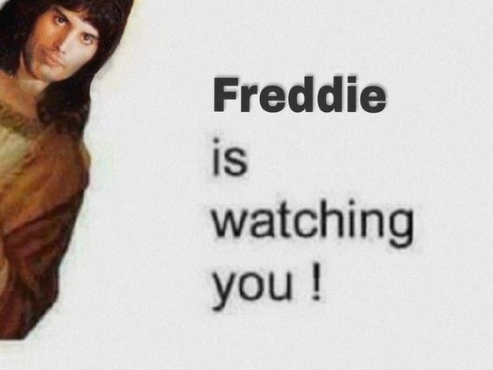
Source:
https://www.borgenmagazine.com/freddie-mercury-the-refugee-from-zanzibar-to-rock-star/

