Slide 1
Muzoon Almellehan
Almellehan was born on April 16, 1999, to Eman and Rakan Almellehan, and brought up in the Syrian city of Daraa. Her father was a schoolteacher. She has two brothers and a sister.
After the Syrian civil war broke out, their city was besieged by the government. In early 2014, her family moved to Jordan when the fighting became severe in 2014 and lived in refugee camps for three years. The Almellehan family was forced to move multiple times. When her family fled from Daraa for the first time to take refuge in the Jordan refugee camps, she claims that all she took with her were her books because education was the most important thing for her. The first camp they lived in was Za'atari, from where they moved to Azraq.

Slide 2
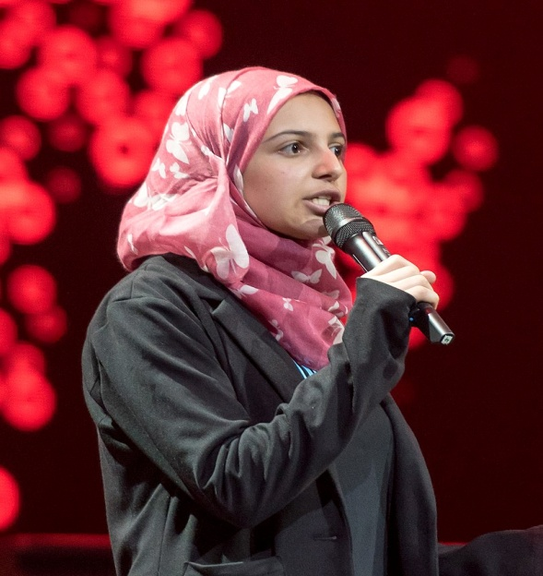
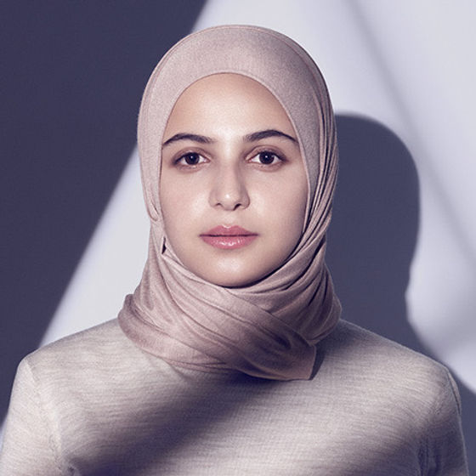
Almellehan was led to advocate for girls' education by the fact that half of the 40 girls in her class at Za'atari dropped out of school to get married. Child marriage, although not particularly common in Syria, increased dramatically after the civil war began. Almellehan became known for trying to persuade parents to leave their children, particularly girls, in refugee schools rather than making them marry early.
Education has given Muzon's life in exile a newfound purpose, and her simple message to the world is that the same can and should be true for every young refugee.

Slide 3
Malala Yousafzai
Malala Yousafzaملاله یوسفزۍ, (born 12 July 1997) is a Pakistani female education activist and the 2014 Nobel Peace Prize laureate. Awarded when she was 17, she is the world's youngest Nobel Prize laureate, and the second Pakistani and the first Pashtun to receive a Nobel Prize.
She is known for human rights advocacy, especially the education of women and children in her native homeland, Swat, where the Pakistani Taliban had at times banned girls from attending school. Her advocacy has grown into an international movement, and according to former Prime Minister Shahid Khaqan Abbasi, she has become Pakistan's "most prominent citizen.

Slide 4
In early 2009, when she was 11, she wrote a blog under her pseudonym Gul Makai for the BBC Urdu about her life during the Taliban's occupation of Swat. The following summer, journalist Adam B. Ellick made a New York Times documentary about her life as the Pakistan Armed Forces launched Operation Rah-e-Rast against the militants in Swat. She rose in prominence, giving interviews in print and on television, and was nominated for the International Children's Peace Prize by activist Desmond Tutu.

Slide 5
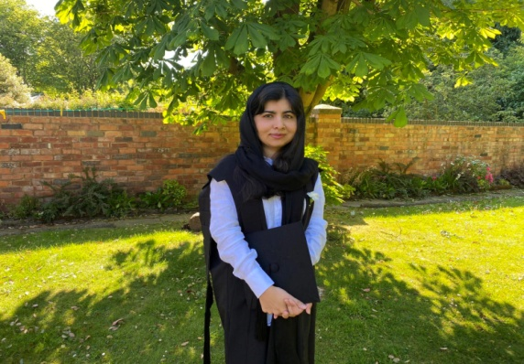
Following the edict, the Pakistani Taliban destroyed several more local schools. On 24 January 2009, Yousafzai wrote: "Our annual exams are due after the vacations but this will only be possible if the Pakistani Taliban allow girls to go to school. We were told to prepare certain chapters for the exam but I do not feel like studying. In February 2009, girls' schools were still closed. In solidarity, private schools for boys had decided not to open until 9 February, and notices appeared saying so.

Slide 6
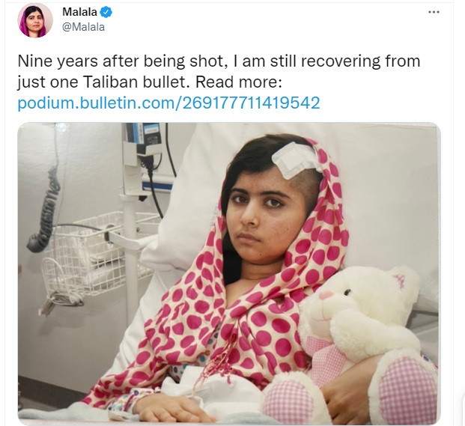
On 9 October 2012, while on a bus in Swat District Yousafzai and two other girls were shot by a Taliban gunman in an assassination attempt to target her for her activism; the gunman fled the scene. She was hit in the head with a bullet and remained unconscious and in critical condition at the Rawalpindi Institute of Cardiology, but her condition later improved enough for her to be transferred to the Queen Elizabeth Hospital in Birmingham, UK.
The attempt on her life sparked an international outpouring of support. Deutsche Welle reported in January 2013 that she may have become "the most famous teenager in the world".

Slide 7
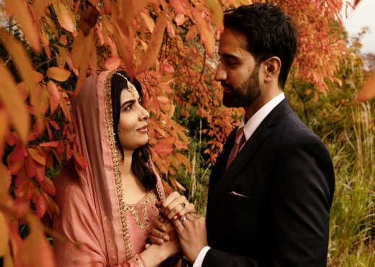
2020 her words… I graduated from Oxford University!
I will always treasure my time at Lady Margaret Hall — the lectures, club meetings, balls and late nights (some spent finishing papers, some just chatting with friends in the dorm). Although a global pandemic meant I spent my final months as a university student in my parents' house, I'm grateful that I was able to complete my education. After taking time to relax, I am more dedicated than ever to my fight for girls.
With more than 130 million girls out of school today, there is more work to be done. I hope you will join my fight for education and equality. Together, we can create a world where all girls can learn and lead.

